Slide 1
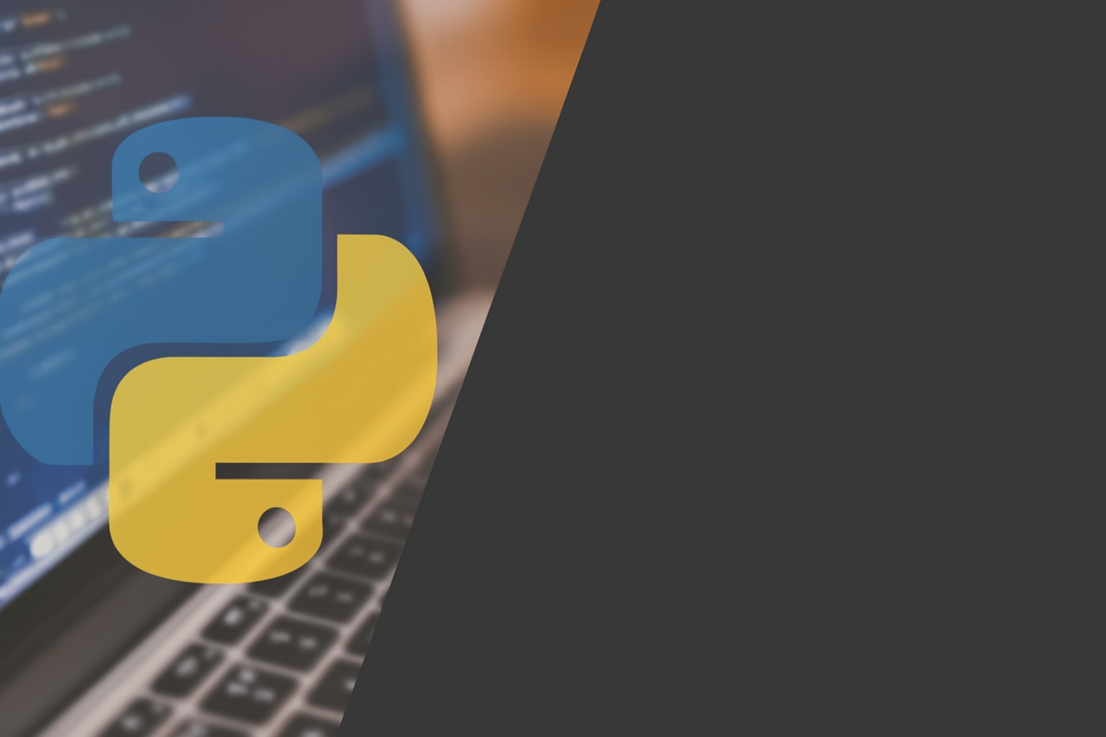
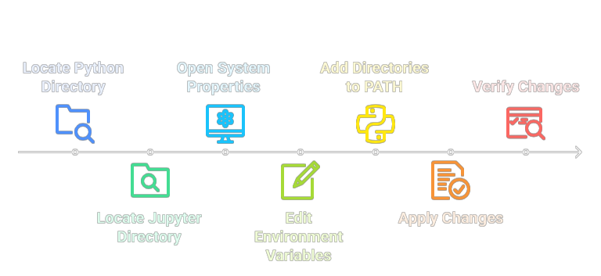
Adding Python & Jupyter to PATH on Windows

Slide 2
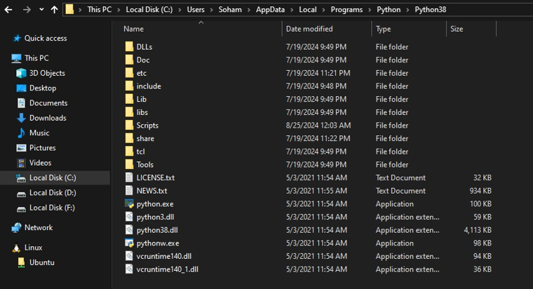
Step 1: Locate Python Installation Directory
The first crucial step is to identify where Python is installed on your system. This is typically found within your user's local application data folder.
Common location: C:\Users\<YourUsername>\AppData\Local\Programs\ Python\PythonXX (where XX is your Python version, e.g., Python39 or Python310).
Also, locate the Scripts folder nested inside your Python directory (e.g., C:\Users\<YourUsername>\AppData\Local\Programs\ Python\PythonXX\Scripts).
These two paths are fundamental for allowing Windows to find Python and its associated tools, like Pip and Jupyter, from any command line location.

Slide 3
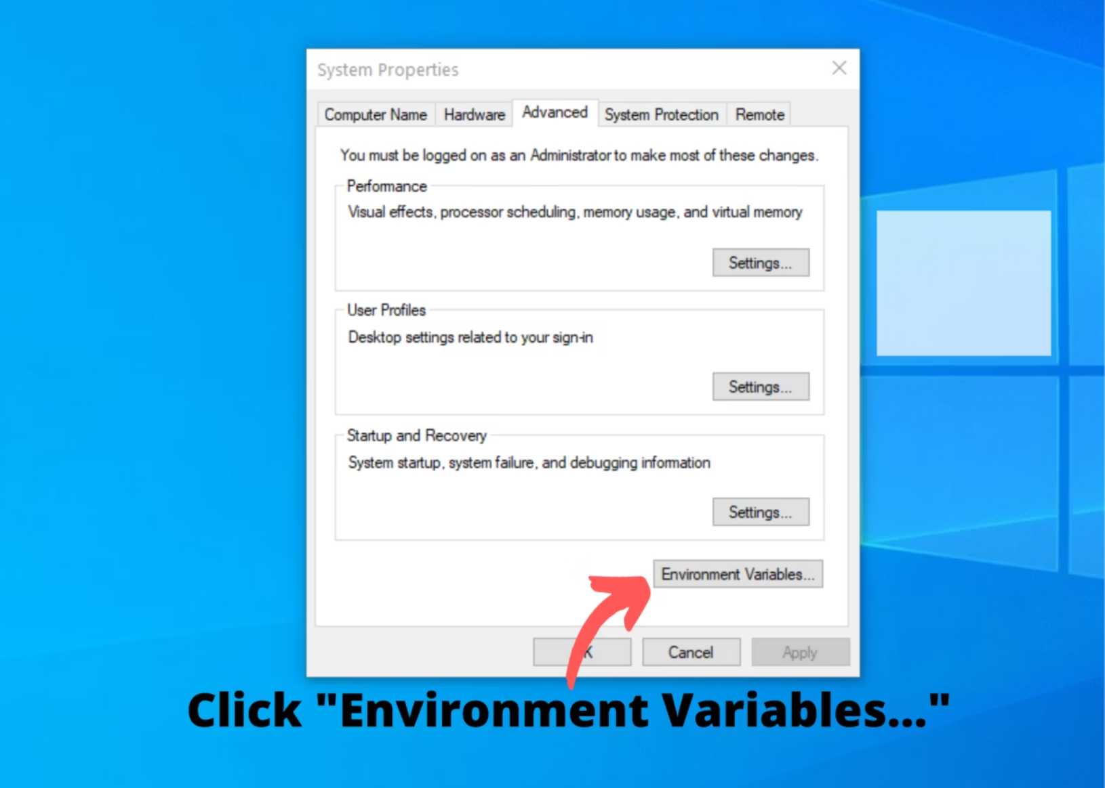
Step 2: Open Environment Variables Settings
Accessing the system's environment variables is the gateway to modifying your PATH. This setting is found within your computer's system properties.
Right-click on This PC (or My Computer) on your desktop or in File Explorer.
Select Properties from the context menu.
In the System window, click on Advanced system settings on the left sidebar.
Finally, within the System Properties dialog, click the Environment Variables... button.
This action will open a new window where you can manage both user-specific and system-wide environment variables.

Slide 4
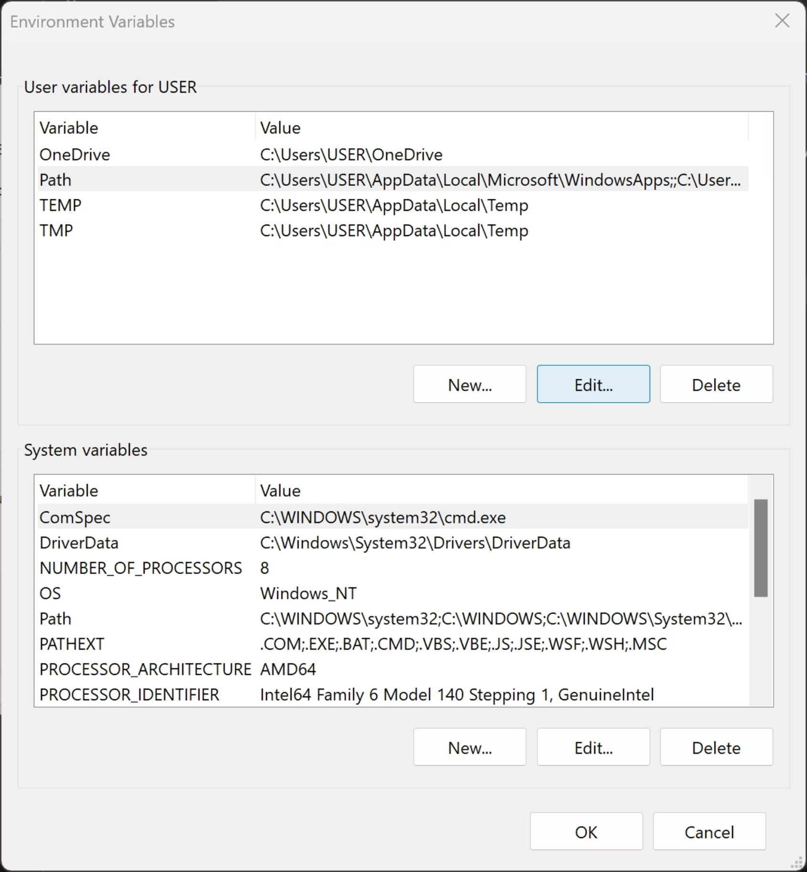
Step 3: Edit the System PATH Variable
Now, it's time to add your Python installation paths to the system's PATH variable. This tells Windows where to look for executable files.
Under the System variables section (usually the bottom list), scroll down and select the variable named Path.
Click the Edit... button.
In the "Edit environment variable" window, click New and paste the full path to your Python installation folder (e.g., C:\Users\YourUsername\AppData\Local\Programs\Python\Python39).
Click New again and paste the path to your Python's Scripts folder (e.g., C:\Users\YourUsername\AppData\Local\Programs\Python\Python39\Scripts).
Ensure both paths are added correctly, then click OK to close the edit window.

Slide 5
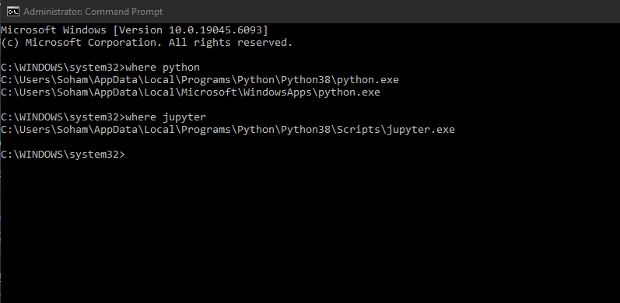
Step 4: Add Jupyter Notebook to PATH
If you've installed Jupyter Notebook using pip (which is the most common method), it's typically placed directly within Python's Scripts directory. Ensure that the Scripts directory is in your PATH (see step 3 in previous slide).
To confirm:
Navigate to your Python's Scripts folder (e.g., C:\Users\<YourUsername>\AppData\Local\Programs\Python\PythonXX\Scripts).
Look for jupyter.exe or similar Jupyter-related executable files.
If you find them, adding the Python Scripts path (as done in Step 3) automatically adds Jupyter to your system's PATH.
You can also use the “where jupyter’” command in Command Prompt to verify if Jupyter is found.

Slide 6
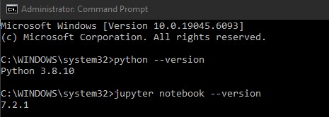
Step 5: Apply Changes and Verify
After making changes to environment variables, it's crucial to ensure they are saved and recognized by your system. This often requires refreshing your command-line interface.
01
02
03
Save All Changes
Refresh Command Prompt
Verify Installation
Click OK on all open dialogs (Edit Path, Environment Variables, System Properties) to apply and save your changes.
Close any existing Command Prompt or PowerShell windows and open a new one. This ensures the updated PATH variable is loaded.
In the new Command Prompt, run:
python --version
jupyter notebook --version
You should see the installed versions printed,
confirming successful PATH configuration.

Slide 7
Troubleshooting Tips
Path Typos
Reboot or Relaunch
Double-check for any spelling errors or incorrect directory separators in the paths you added to the PATH variable. Even a small mistake can prevent recognition.
If commands are still not recognized, try restarting your Command Prompt/PowerShell or even your entire PC to ensure the environment variables are fully refreshed.
Confirm Executables
Anaconda Specifics
Use where python and where jupyter in the command prompt. This will show you the exact path Windows is finding for these executables, or confirm if they are not found at all.
If you are using Anaconda, you must add Anaconda's specific Python and Scripts paths instead of the standalone Python installation paths. Anaconda often manages its own environment, so consult Anaconda documentation for precise instructions.

